Slide 1


Fundamentals of Management
Eleventh Edition
Chapter 8
Organizational Structure and Design
Copyright © 2020, 2017, 2015 Pearson Education, Inc. All Rights Reserved

Slide 2
Learning Objectives
8.1 Describe six key elements in organizational design.
8.2 Identify the contingency factors that favor either the mechanistic model or the organic model of organizational design.
8.3 Compare and contrast traditional and contemporary organizational designs.
8.4 Discuss the design challenges faced by today’s organizations.

Slide 3
Learning Objective 8.1
Describe six key elements in organizational design.

Slide 4
Elements of Organizational Structure
Work specialization
Departmentalization
Authority and responsibility
Span of control
Centralization versus decentralization
Formalization
Getting work done efficiently & effectively.

Slide 5
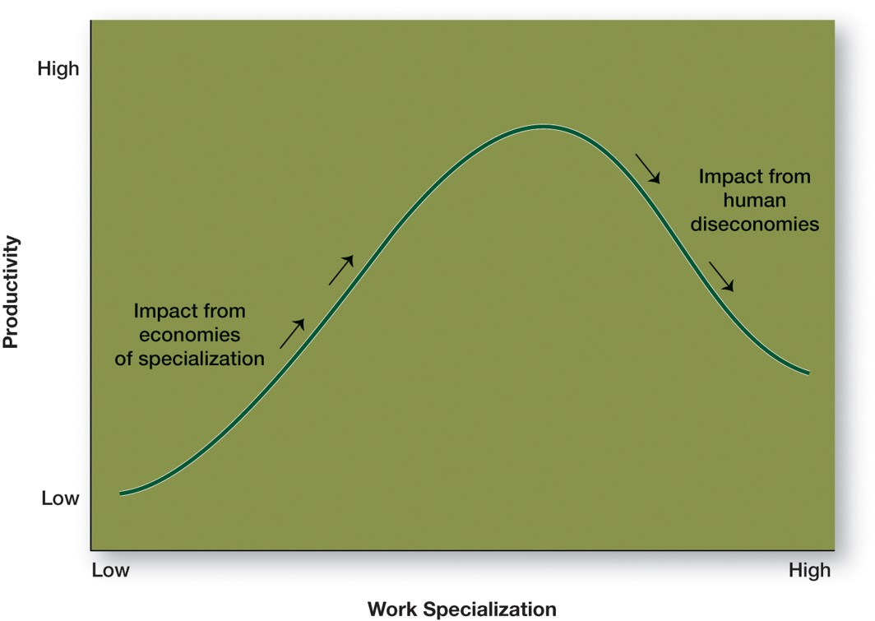
Work Specialization
Exhibit 8.1 Economies and Diseconomies of Work

Slide 6
Departmentalization
Exhibit 8.2 Types of Departmentalization
Functional
  Groups employees based on work performed (e.g., engineering, accounting, information systems, human resources)
Product
  Groups employees based on major product areas in the corporation (e.g., women’s footwear, men’s footwear, and apparel and accessories)
Customer
  Groups employees based on customers’ problems and needs (e.g., wholesale, retail, government)
Geographic
  Groups employees based on location served (e.g., North, South, Midwest, East)
Process
  Groups employees based on the basis of work or customer flow (e.g., testing, payment)

Slide 7
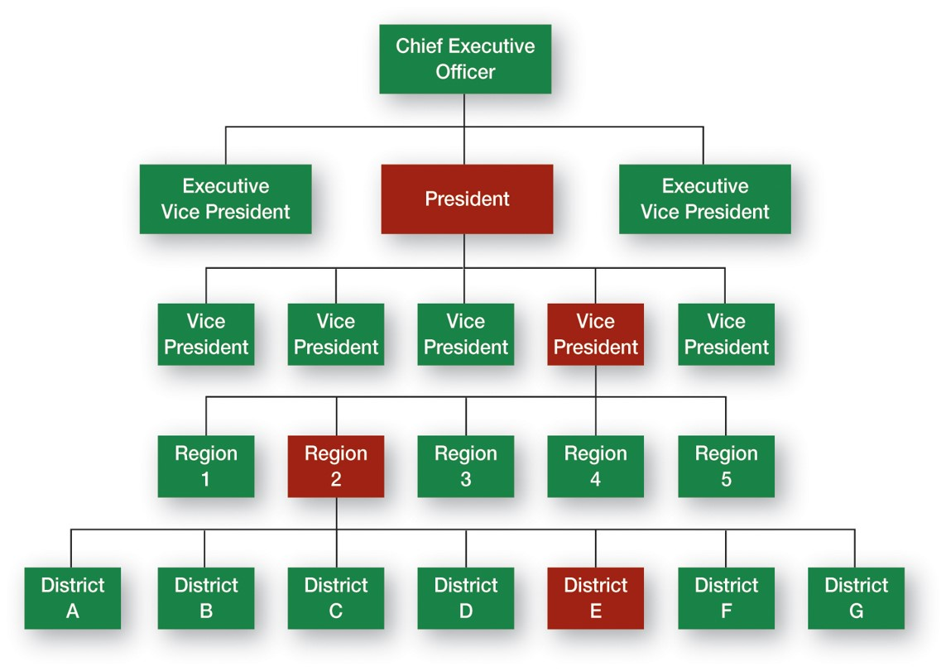
Types of Authority Relationships
Exhibit 8.3 Chain of Command and Line Authority

Slide 8
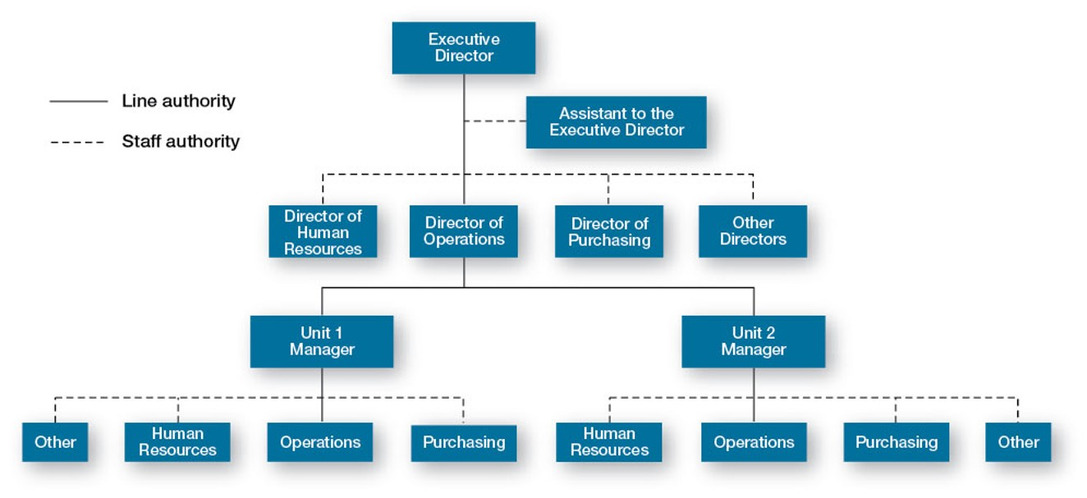
Line and Staff Authority
Exhibit 8.4 Line versus Staff Authority

Slide 9
Unity of Command
A structure in which each employee reports to only one manager
One boss or more?

Slide 10
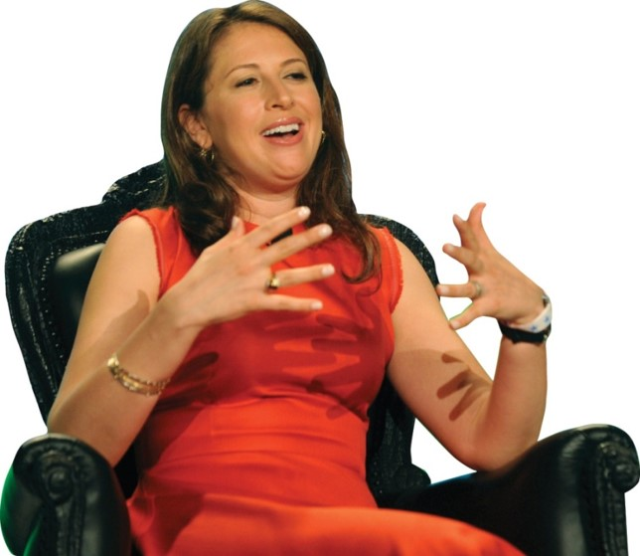
How Do Authority and Power Differ?
Authority:
a right whose legitimacy is based on an authority figure’s position in the organization; it goes with the job.
Power:
an individual’s ability to influence decisions.

Slide 11
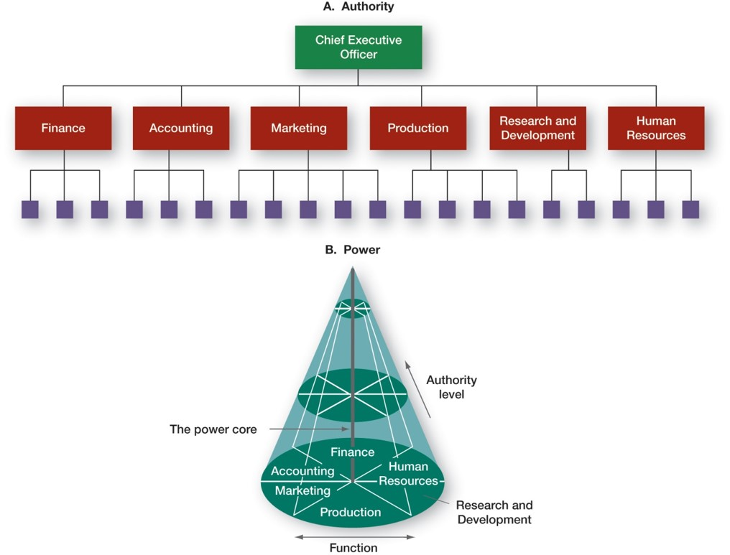
Power versus Authority
Exhibit 8.5 Authority versus Power

Slide 12
Types of Power
Exhibit 8.6 Types of Power
Coercive power
  Power based on fear.
Reward power
  Power based on the ability to distribute something that others value.
Legitimate power
  Power based on one’s position in the formal hierarchy.
Expert power
  Power based on one’s expertise, special skill, or knowledge.
Referent power
  Power based on identification with a person who has desirable resources or personal traits.

Slide 13
Span of Control
Effective and efficient span depends on:
Employee experience and training (more they have, larger span)
Similarity of employee tasks (more similarity, larger span)
Complexity of those tasks (more complex, smaller span)

Slide 14
Centralization and Decentralization
Centralization:
decision making takes place at upper levels of the organization.
Decentralization:
lower-level managers provide input or actually make decisions.

Slide 15
Formalization
How standardized an organization’s jobs are and the extent to which employee behavior is guided by rules and procedures

Slide 16
Learning Objective 8.2
Identify the contingency factors that favor either the mechanistic model or the organic model of organizational design.

Slide 17

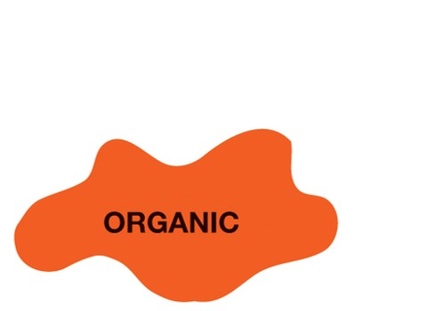
Models of Organizational Design
Exhibit 8.7 Mechanistic versus Organic Organizations
Rigid hierarchical relationships
Fixed duties
Many rules
Formalized communication channels
Centralized decision authority
Taller structures
Collaboration (both vertical and horizontal)
Adaptable duties
Few rules
Informal communication
Decentralized decision authority
Flatter structures

Slide 18


Strategy and Structure
Certain structural designs work best with different organizational strategies:
Simple strategy
Simple structure
Elaborate strategy
More complex structure

Slide 19
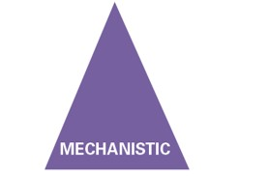

Size and Structure
Organic:
less than 2,000 employees can be organic.
Mechanistic:
more than 2,000 employees makes organizations to become more
more than 2,000 employees forces organizations to become more mechanicstic
fewer than 2,000 employees can be organic

Slide 20
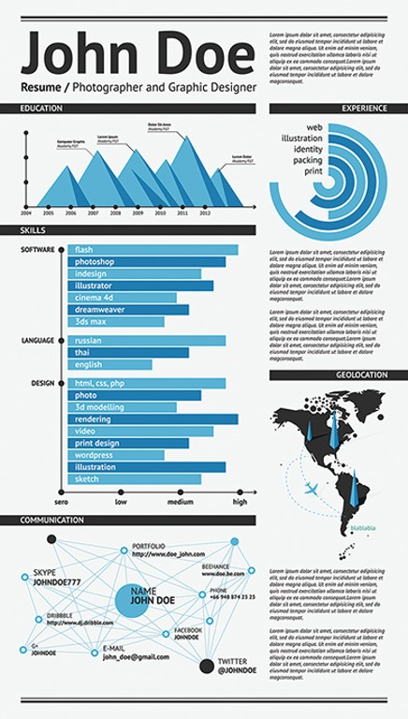


Technology and Structure
Your smartphone or tablet standardized assembly line
Your bottle of ibuprofen continuous-flow production process
Your Résumé custom design and print

Slide 21
Environment and Structure
Stable environment: mechanistic structure
Dynamic environment: organic structure

Slide 22
Learning Objective 8.3
Compare and contrast traditional and contemporary organizational designs.

Slide 23
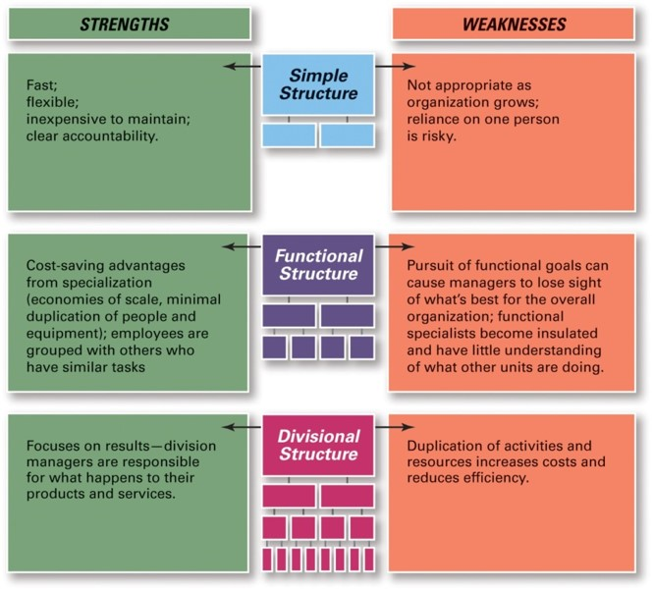
Traditional Organizational Designs
Exhibit 8.9 Traditional Organization Designs
Source: Robbins, Stephen P., Coulter, Mary, Management, 13th E d., © 2016, p. 304. Reprinted and electronically reproduced by permission of Pearson Education, Inc., New York, N Y

Slide 24
Functional Structure
An organizational design that groups similar or related occupational specialties

Slide 25
Divisional Structure
An organizational structure made up of separate business units or divisions

Slide 26
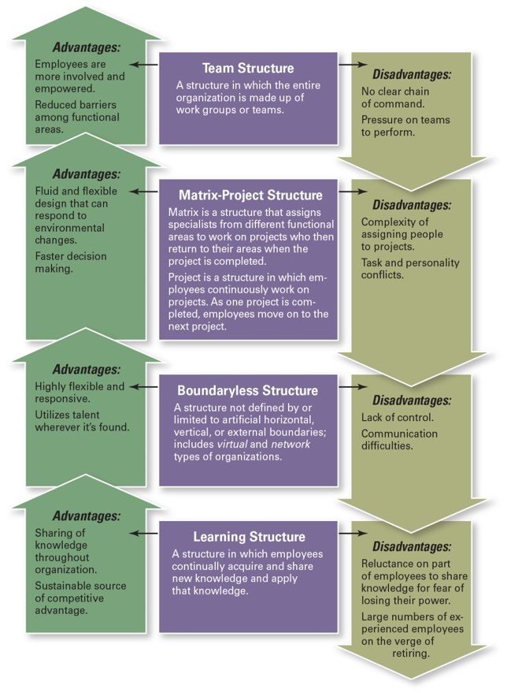
Contemporary Organizational Design
Exhibit 8.10 Contemporary Organization Designs
Lean. Flexible. Innovative.
Source: Robbins, Stephen P., Coulter, Mary, Management, 13th E d., © 2016, p. 315. Reprinted and electronically reproduced by permission of Pearson Education, Inc., New York, N Y.

Slide 27
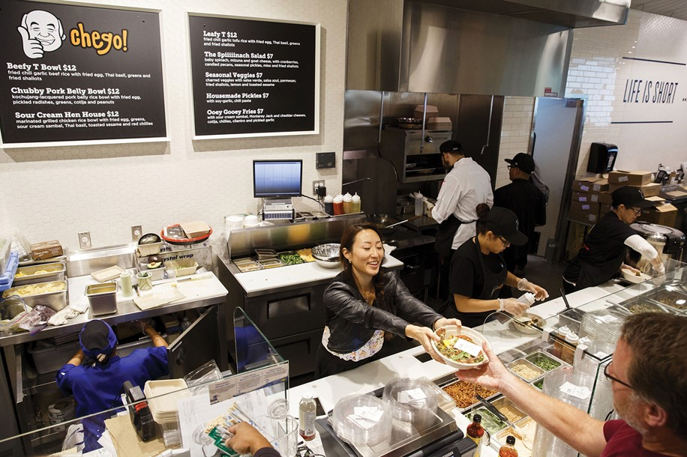
Team Structure
A structure in which the entire organization is made up of work teams that do the organization’s work

Slide 28
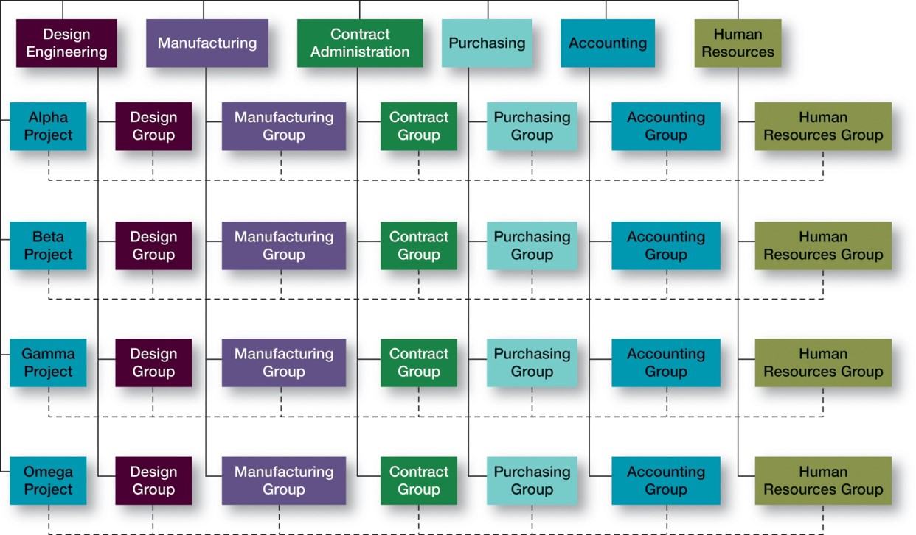
Matrix and Project Structures
Exhibit 8.11 Sample Matrix Structure

Slide 29
Project Structure
A structure in which employees continuously work on projects

Slide 30
Boundaryless Organizations
An organization whose design is not imposed by a predefined structure

Slide 31
Learning Objective 8.4
Discuss the design challenges faced by today’s organizations.

Slide 32
Current Organizational Design Challenges
Keeping employees connected
Managing global structural issues
Building a learning organization
Designing flexible work arrangements
Changing the Way Work Is Done

Slide 33
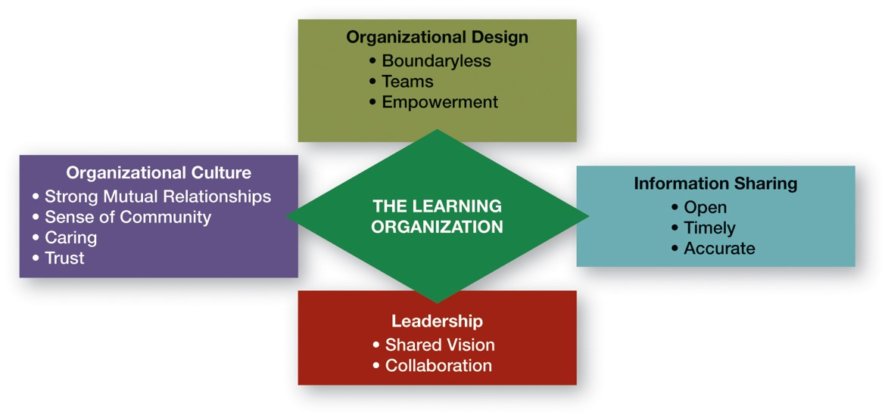
A Learning Organization
Exhibit 8.12 Characteristics of a Learning Organization
Sources: Based on P. M. Senge, The Fifth Discipline: The Art and Practice of Learning Organizations (New York: Doubleday, 1990); and R. M. Hodgetts, F. Luthans, and S. M. Lee, “New Paradigm Organizations: From Total Quality to Learning to World Class,” Organizational Dynamics, Winter 1994, p p. 4–19.

Slide 34

Flexible Work Arrangements
Remote work
Telecommuting
Compressed workweek
Flextime
Job Sharing
Contingent workers

Slide 35

Copyright
This work is protected by United States copyright laws and is provided solely for the use of instructors in teaching their courses and assessing student learning. Dissemination or sale of any part of this work (including on the World Wide Web) will destroy the integrity of the work and is not permitted. The work and materials from it should never be made available to students except by instructors using the accompanying text in their classes. All recipients of this work are expected to abide by these restrictions and to honor the intended pedagogical purposes and the needs of other instructors who rely on these materials.

